Slide 1
Joint Policing Committee – Tipperary Division
3rd March 2023
Chief Superintendent Colm O’Sullivan

Slide 2
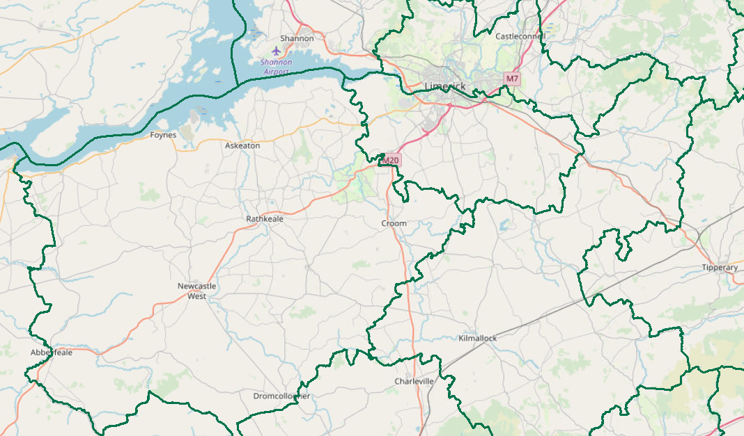
JPC Objectives:
Provide a brief statistical overview of current position as of 02/03/2023:
Property Crime at a Divisional Level (broken down by District)
Additional attention afforded to Burglary
Crime Against the Person at a Divisional Level (broken down by District)
Additional attention afforded to Assault
Proactive Policing Measure
Includes Possession of Drugs, Sale of Drugs, Firearms and Offensive Weapons
Statistics relating to Topics 1 to 3 are based on Dec 2021, Jan and Feb 2022 (3 mth period) compared with Dec 2022, Jan and Feb 2023 (3 mth period)
Traffic
Fatalities/Serious Injuries figures YTD
Drink Driving and Drug Offences YTD
LifeSaver Offences (2021 vs. 2022)
Domestic Abuse Incidents (1st Jan – 26th Feb, 2022 vs. 2023)
All information is based upon operational data from the PULSE System as was available on the 02/03/2023, unless otherwise stated and is liable to change. Crime Counting rules are applied, unless otherwise stated. Incident counts are based on date reported.

Slide 3
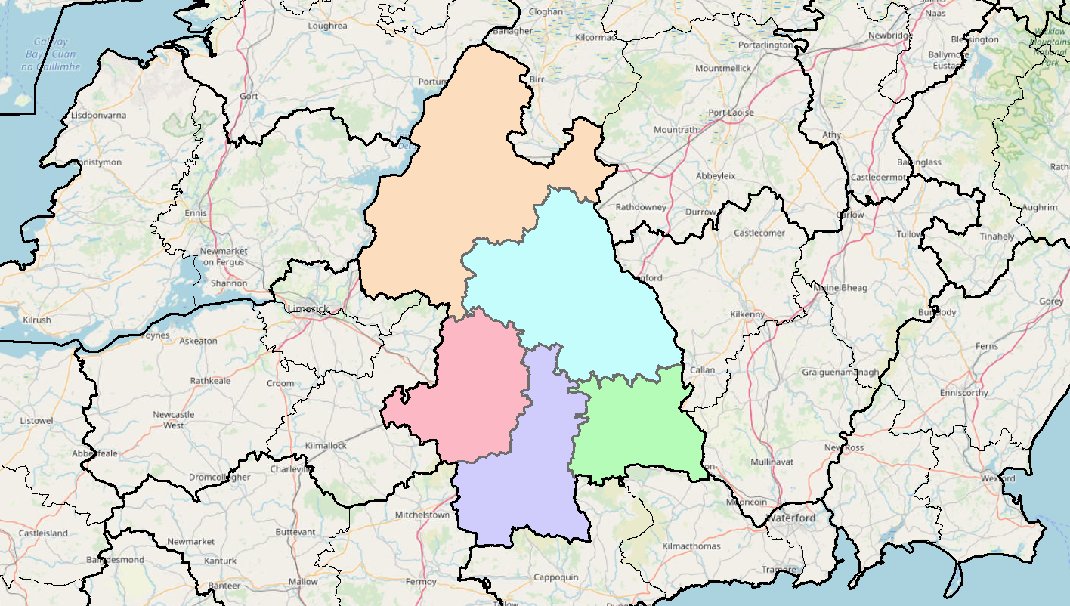
Property Crime includes:
All Robbery
All Burglary
And various Theft Offences
3mth Change in the Division is -11%
(375 to 335)
+0%
(65 to 65)
Statistics are based on Dec 2021 & Jan, Feb 2022 (3 mth period) compared with Dec 2022 & Jan, Feb 2023 (3 mth period)
+0%
(68 to 68)
-25%
(48 to 36)
-9%
(138 to 125)
-27%
(56 to 41)
Detections are -40% (169 to 101)

Slide 4
Non Aggravated Burglary
3mth change in the Division is -32% (81 to 55)
-56%
(25 to 11)
Statistics are based on Dec 2021 & Jan, Feb 2022 (3 mth period) compared with Dec 2022 & Jan, Feb 2023 (3 mth period)
Residential Burglary is -41%
Non Residential Burglary is +7%
-52%
(21 to 10)
+83%
(Figures are less than 10)
-41%
(22 to 13)
+43%
(Figures are less than 10)
Detections are +25%

Slide 5
Crimes Against the Person includes
Murder
Murder Threat
All Assaults
Harassment
Child Abandonment
Neglect or Cruelty
3mth change in the Division is -27%
(179 to 131)
-32%
(41 to 28)
Statistics are based on Dec 2021 & Jan, Feb 2022 (3 mth period) compared with Dec 2022 & Jan, Feb 2023 (3 mth period)
+3%
(34 to 35)
-56%
(Figures are less than 10)
-40%
(63 to 38)
-4%
(23 to 22)
Detections are -75% (87 to 22)

Slide 6
Assaults includes:
Assaults Causing Harm
Minor Assaults
3mth change the Division is -11%
(123 to 109)
-4%
(24 to 23)
Statistics are based on Dec 2021 & Jan, Feb 2022 (3 mth period) compared with Dec 2022 & Jan, Feb 2023 (3 mth period)
Assaults Causing Harm: -23% (48 to 37)
Minor Assaults: -4% (75 to 72)
+23%
(22 to 27)
-43%
(Figures are less than 10)
-31%
(45 to 31)
+11%
(18 to 20)
Detections are -73% (68 to 18)

Slide 7
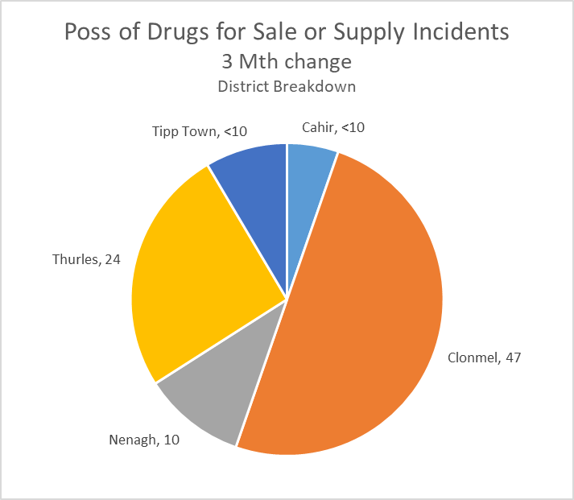
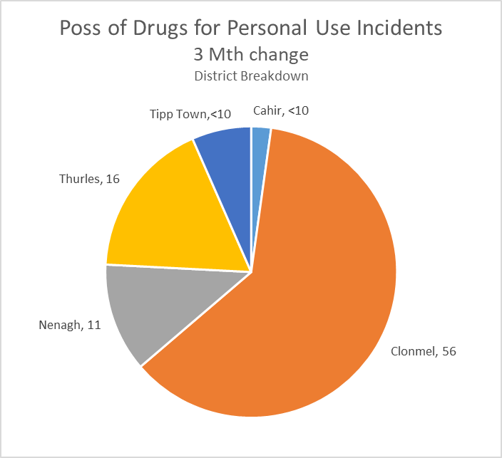
Proactive Policing Measures
Statistics are based on Dec 2021 & Jan, Feb 2022 (3 mth period) compared with Dec 2022 & Jan, Feb 2023 (3 mth period)
Possession of Drugs for Sale/Supply
Down 34% 3mth change
(35 to 23)
Possession of Drugs for Personal Use
Down 3% 3mth change
(97 to 94)
Overall Searches within the Division are down 7%
Possession of Firearms/Offensive Weapons
-7% 3mth change
(15 to 14)
*Crime Counting Rules not applied

Slide 8
Traffic (YTD 2022 v 2023)
Fatal Collisions are down 100%
Serious Injury Collisions are down 17%
There have been 575 MIT Checkpoints conducted in the Division – (down 5% from 607 in 2022)
This has resulted in 56 Driving While Intoxicated Offences (up 51% from 37 in 2022)
Our most recent data regarding LifeSaver Offences shows the following Jan to Dec Trends (2021 v. 2022)
-34%
(906 to 601)
+30%
(223 to 290)
-23%
(4,683 to 3,604)
Notes:
LifeSaver Offences:
Mobile Phone
Seatbelt
Speeding - Intercept

Slide 9
Domestic Abuse Incidents
includes
Domestic Violence
Breach of Barring Order
Breach of Protection Order
Breach of Safety Order
Domestic Dispute
Domestic Dispute – No Offence Identified
Any incident with Domestic M.O.
YTD (1st Jan – 26th Feb, 2022 v 2023)
the Division is
+18%
Based upon operational data from the PULSE System as was available on the 27/02/2023 and is liable to change. Incident counts are based on date reported.
Notes:
Jan 2020 compared with Jan 2021

