Slide 1
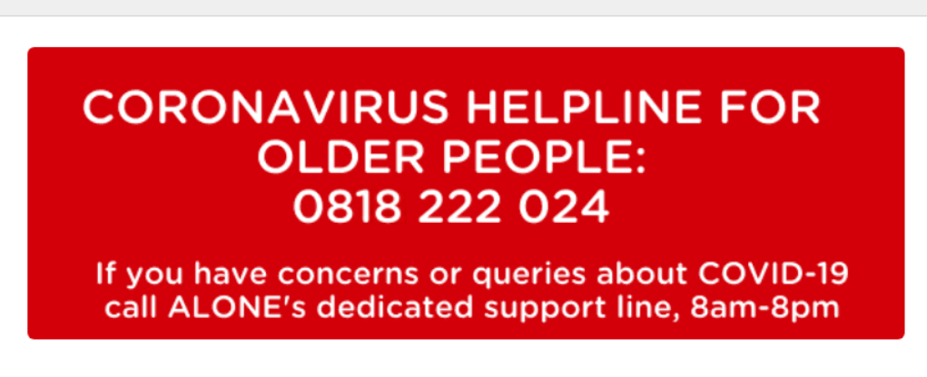
Alone Contact Information
Carlow
Telephone: 059 913 6340
Email: hello@alone.ie
Address: ALONE,
St Dympna’s Hospital Complex,
Athy Road,
Co. Carlow.
Kilkenny
Telephone: 056 777 2151
Email: hello@alone.ie
Address: ALONE,
St Canice’s Neighbourhood Centre,
Butts Green,
Co. Kilkenny..

Slide 2
Regional Positive Ageing Week 2020 Partners

Slide 3
This Regional Action for Positive Ageing has been funded by The Healthy Ireland Fund, supported by the Department of Health and the Department of Children and Youth Affairs

