Slide 1

Thurles Municipal District
Enhancement Supports
Sharon Scully
District Administrator
20th November 2022

Slide 2



Thurles Municipal District Town Enhancement Support Schemes
Thurles Municipal District offer a number of annual grant schemes to property owners across the District.
The objective of these grant schemes is to enhance the streetscape environment of towns within Thurles Municipal District by encouraging and supporting businesses, property owners and local community groups to improve their individual shopfronts, building facades and general streetscape.
The schemes if utilised will result in a more attractive environment that residents, visitors, shoppers and businesses can enjoy.

Slide 3
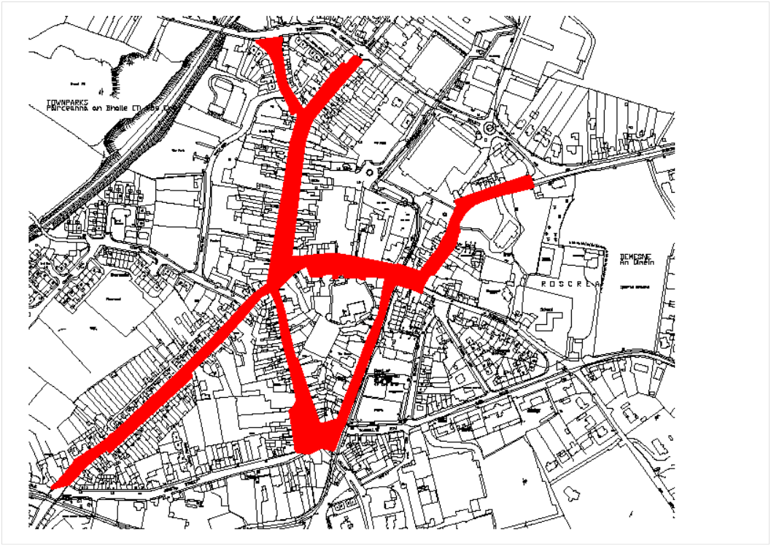
Thurles Municipal District Painting Enhancement Scheme
The focus of this grant scheme is to target properties within Roscrea’s prime retail area of
Main Street, Castle Street , Limerick Street, Grove Street, Rosemary Street, Rosemary
Square, Market Square, Church Street, Green Street & The Mall
The scheme provides funding to commercial, residential properties and vacant / derelict
units.
Item permitted under the scheme
Painting and general improvements to Commercial and Residential building frontages
Removal of inappropriate contemporary signage, fittings and general clutter and replacement with shop fascia signage
Erection of planters, floral hanging baskets or other environmental improvements
Terms of the scheme
Maximum Grant: 50% of the approved cost of the works subject to a maximum of €500.

Slide 4
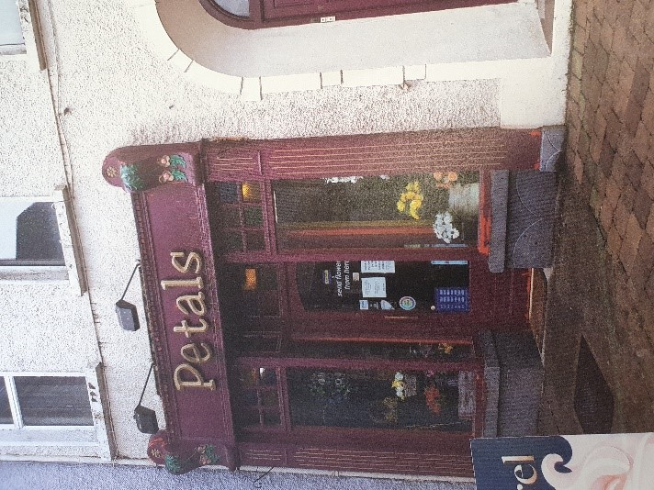
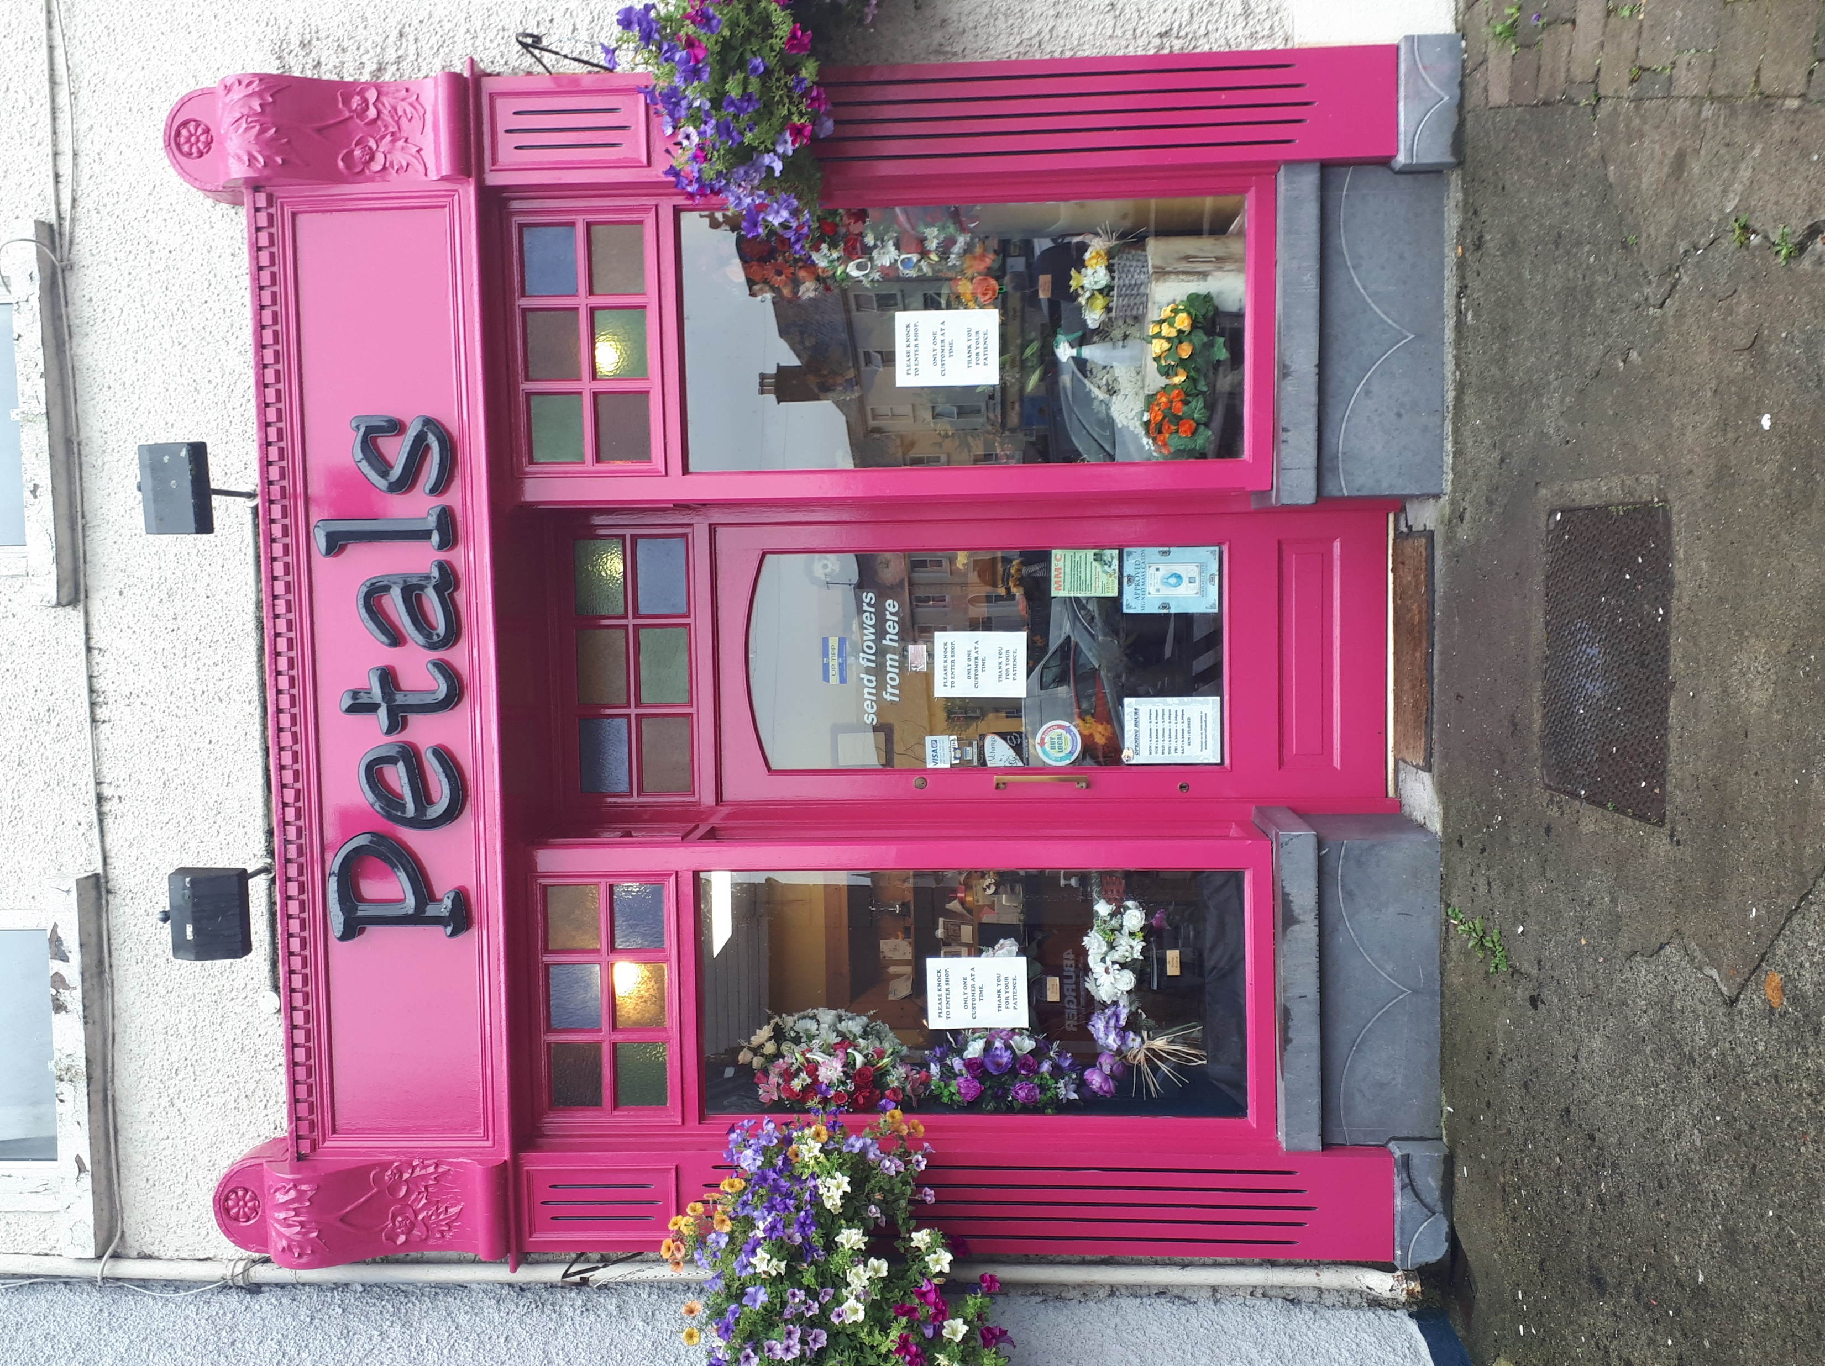
Thurles Municipal District Painting Enhancement Scheme

Slide 5
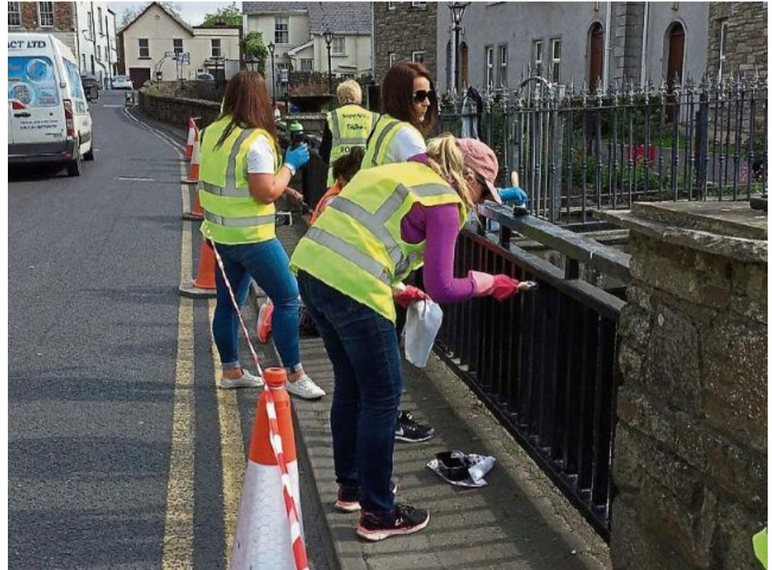
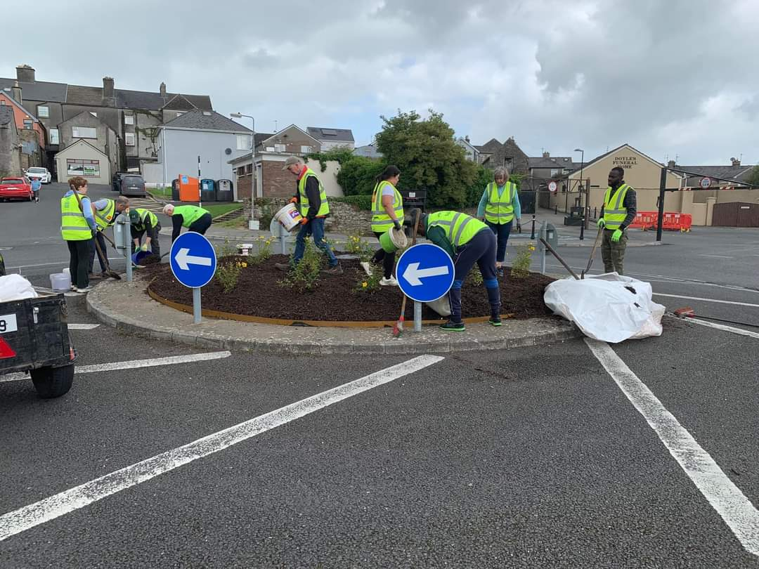
Thurles Municipal District Tidy Towns Grants
Thurles Municipal District awarded grants to 24 Tidy Towns/Community Committees in 2023.
Eligibility for the Scheme:
Under the Scheme community projects/works which enhance the appearance
of the local area/village/town can be funded
Applicants must be a recognised Community/Tidy Towns Group involved in
activities to enhance and improve the appearance of the local area/village/town.

Slide 6
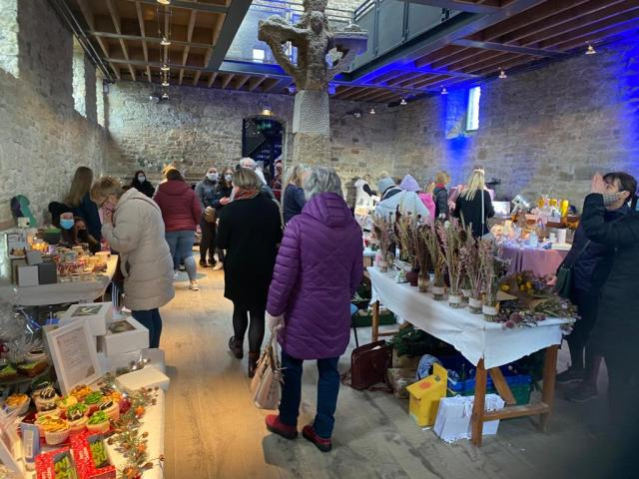
Thurles Municipal District Festival & Events Grant Scheme
Thurles Municipal District provide financial support to business and community groups to support events and festivals in culture, food, sports and activity based tourism to attract visitors.
Festival & Event grants were approved for 19 organisations and groups across Thurles Municipal District in 2023.
Eligibility for the Scheme:
The maximum amount which can be applied for under this
grant scheme is €15,000

Slide 7
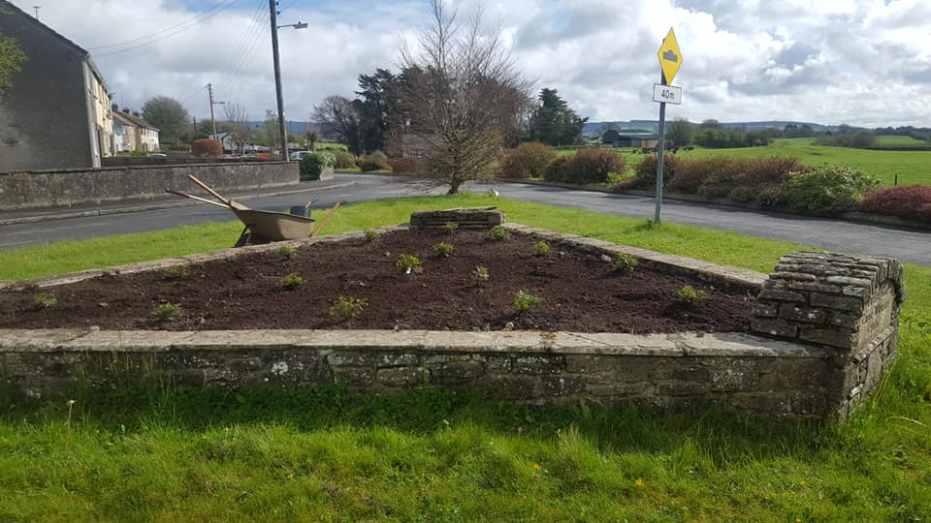
Thurles Municipal District Residents Association Grant Scheme
Thurles MD awarded grants for maintenance and improvement works in housing estates to 37 Residents Associations in 2023
Eligibility for the Scheme:
Under the Scheme community projects/works which enhance the
appearance of the local area/village/town can be funded

Slide 8
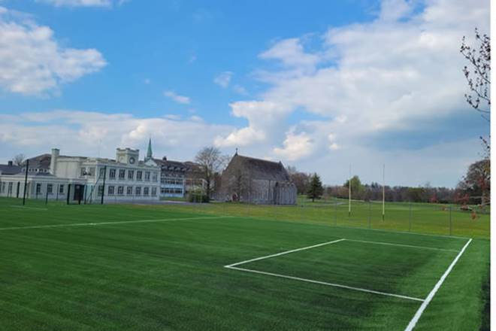
Thurles Municipal District Sports Clubs Grant Scheme
Thurles MD awarded grants to 49 Sports Clubs in 2023
Eligibility for the Scheme:
Financial support is provided to community and voluntary
sporting organisations to develop and improve sports and recreation
premises, pitches and equipment

Slide 9

Thurles Municipal District Christmas Retail Support Grants
Thurles Municipal District in 2023 in conjunction with the Tipperary Local Enterprise Office offered support for retailers & businesses to implement activities designed to enable increased spending in towns and villages over the Christmas period.
Town Centre Teams, Trader Associations, Chambers of Commerce, Community Groups, Farmers Markets, or Craft Markets were invited to apply for funding under the scheme.
Grantees were awarded a grant of between €300 and €3,000 to be spent on
activities including advertising, promotions, street entertainment or other
expenses for their Christmas events.

Slide 10
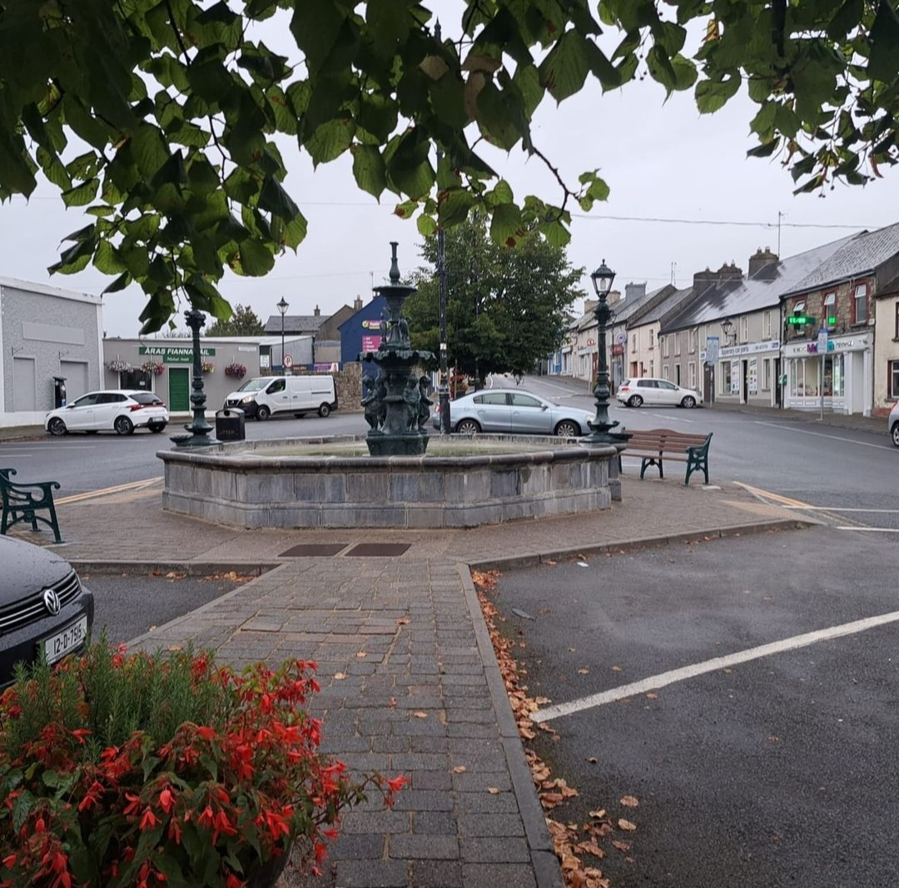
Thurles Municipal District National Enhancement Schemes
In previous years Thurles Municipal District has secured one off funding for Roscrea under the following national funding schemes -
Department of Rural & Community Development’s Streetscape Enhancement Measure -
The scheme targeted unsightly and vacant or derelict properties with a maximum grant of €8000 offered to property owners to enhance their premises facades
Fáilte Ireland Outdoor Seating Grants
This scheme was launched to provide support to hospitality and tourism businesses to provide additional outdoor seating and increase their outdoor seating capacity.
Department of Housing, Local Government and Heritage - Built Heritage Investment Scheme
Funding was sourced under the Built Heritage and Investment Scheme to carry out cleaning and repair works to the fountain on Rosemary Street.

Slide 11
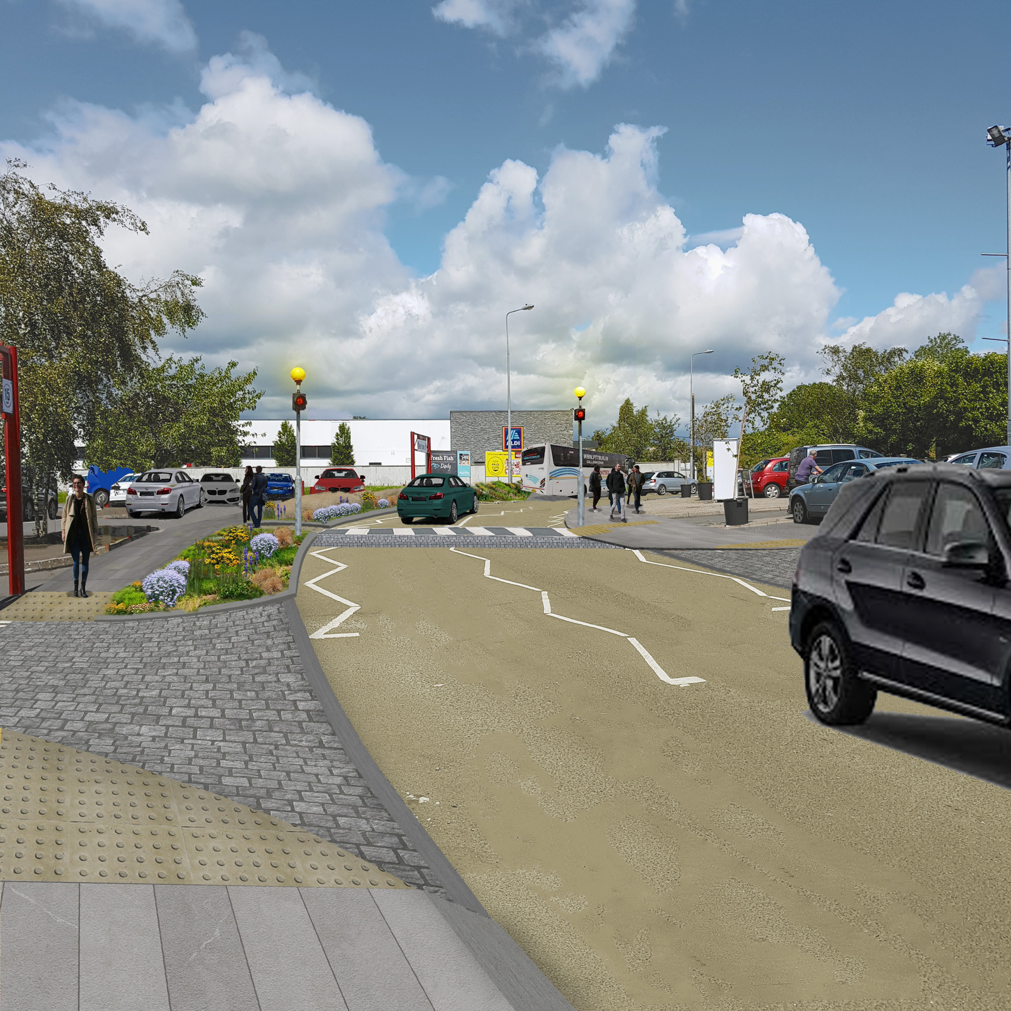
Thurles Municipal District Enhancement Scheme Funding
Thurles Municipal District will continue to target all available national funding for projects that will have an impact on the visual appearance of Roscrea’s main thoroughfare under funding calls such as -
Rural Regeneration Development funding (RRDF)
Outdoor Recreation and Infrastructure Scheme (ORIS)
Town & Village Renewal
Just Transition Funding Scheme
Funding from schemes such as these will bring about transformational change which will
build on the success of securing funding for the Gantly Street Age
Friendly Neighbourhood and the REACH project.

Slide 12
Tipperary Town Streetscape Enhancement Scheme 2022
Sharon Scully
District Administrator
20th November 2023

