Slide 1

NENAGH TOWN CENTRE FIRST PLAN
INTEGRATED URBAN STRATEGY

Slide 2
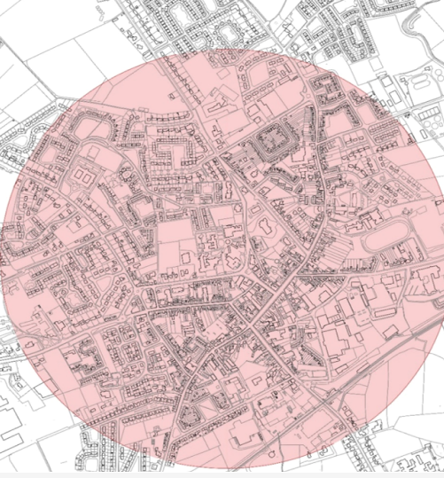
INTEGRATED URBAN STRATEGY
Sits within the framework of Town Centre First Policy
Contribute to a reimagining of the town and the way people use it
Capitalise on potential offered by URDF and RRDF funding and other potential funding sources
Set out a clear and action-based strategy for the future development and revitalization of Nenagh
Identify projects that promote the conservation and adaptive reuse of the built heritage while reducing vacancy and dereliction in the Town Centre
Address the prioritization, development and specification of project proposals to create a pipeline of investment-ready public realm, built heritage refurbishment, renovation and adaptive reuse projects

Slide 3
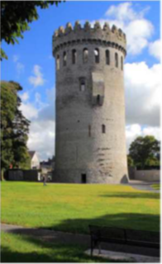
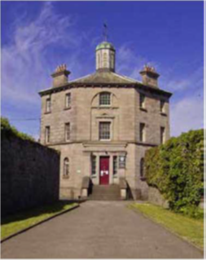
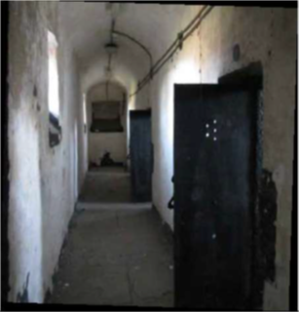
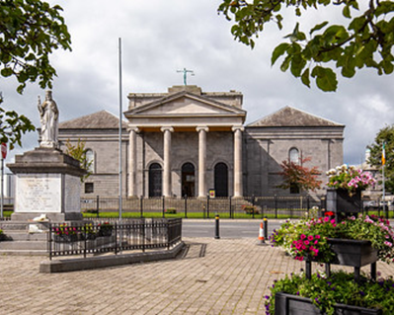
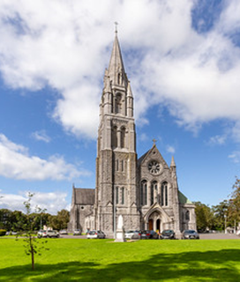
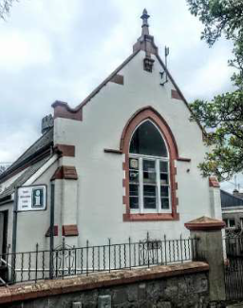
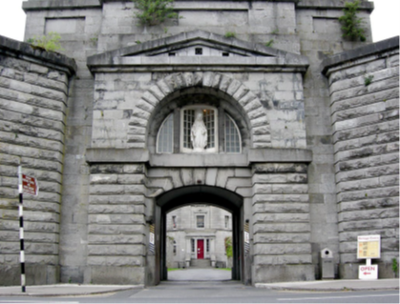
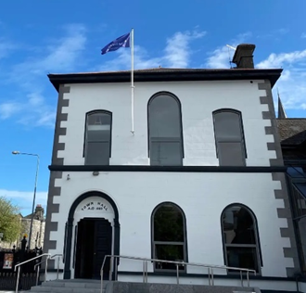
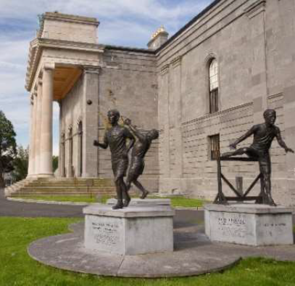
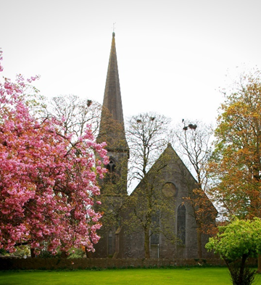
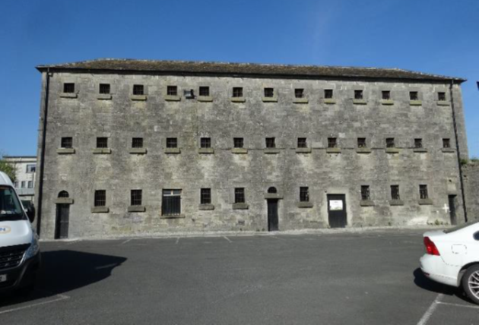
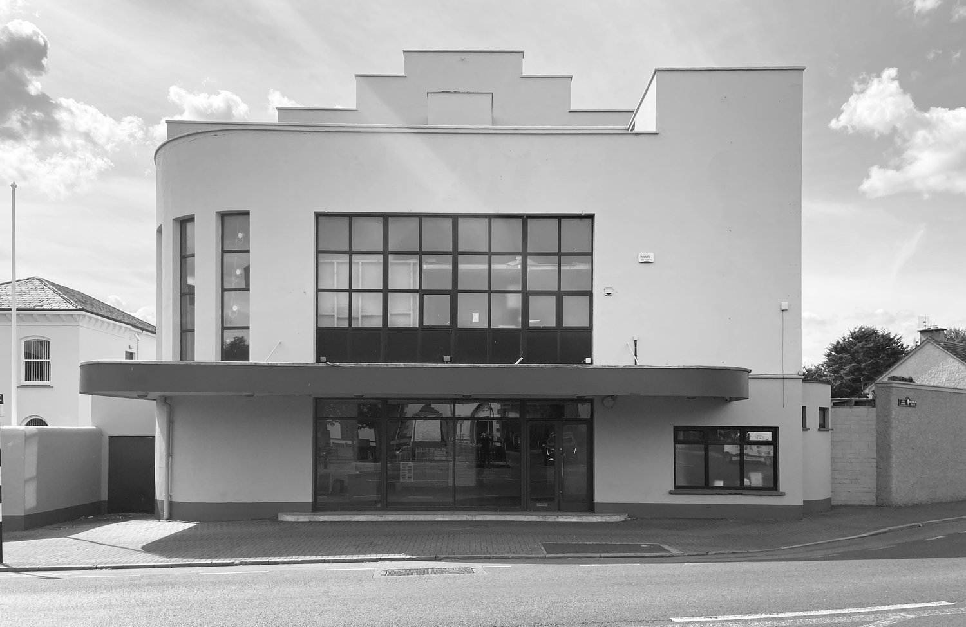
NENAGH – A TOWN WITH A STORY TO TELL

Slide 4
WHAT WE WANT TO ACHIEVE
Maximise the return on the Tourism & Heritage assets – Lough Derg, the Historic & Cultural Quarter – increase visitor numbers – increase job creation
Nenagh as a destination – historic exploration, walking, cycling, literary, music, art, culture etc.
Strategic Location
Tackle vacancy and dereliction
Focus on outdoor amenities & opportunities, facilities and services – improve quality of life for the citizen
Identify ways & means to support existing retailers and attract more shoppers
Festivals & Events
Public Transport connections
15 year Plan

Slide 5

First Impressions – What People Like about Nenagh
Community Spirit
  Friendly town with helpful, welcoming people
  Strong sense of local identity and pride
Heritage & Character
  Historical Assets – Nenagh Castle, Gaol, Traditional Shopfronts
Independent Local Businesses
  Artisan shops, cafés, restaurants, services
  Variety, personal touch
Compact, Walkable Town Centre
  Easy to walk around
  Essential amenities, shops and public buildings within a short distance
Proximity to Lough Derg and Nature
  Lough Derg, parks, countryside
  Access to outdoor recreation and scenic beauty
Central Location/Accessibility
  Connectivity – M7 motorway, Local Link, Rail, Bus
Cultural Amenities & Events
  Festivals, events, music, arts groups
Family Friendliness
  Suitability for families – schools, sports clubs, playgrounds, community
Market Town Tradition
  Country market, Farmers’ Market, food heritage, artisan producers

Slide 6
The Process
Community-led Plan
Community Questionnaire
Meet the Town Team Event

Slide 7
The Outcome – Community Questionnaire
880 electronic responses
77 hard copy surveys
10% of Nenagh population
Nearly half the respondents were 45-64 age group
Only 10% below 24 years of age
Large majority residents of Nenagh
90% frequent visitors to the town
More than half visit daily
Main reason for visiting:
  Shopping
  Visiting family/friends
  Walking/exercise
  Volunteering/community groups
  Children’s extra-curricular activities
  Church

Slide 8
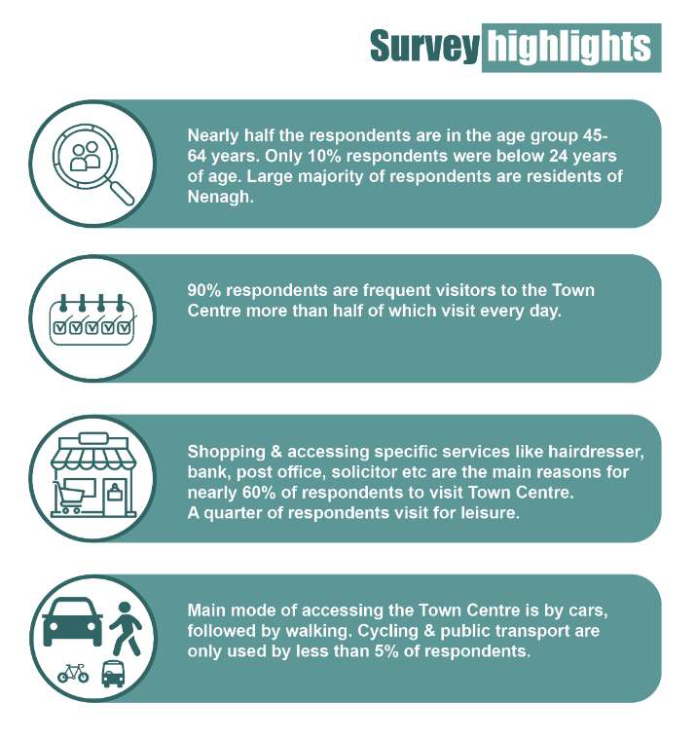

Slide 9
Aspirations for the Town Centre
Community Hub & Use of Old Buildings
Transport and Accessibility
Events & Cultural Activities
Urban Realm & Environment
Youth and Teen Facilities
Housing and Mixed-Use Development
Local Econonmy & Shop Fronts

Slide 10
Other Ideas & Aspirations for the Town
Culture & Tourism
  Norman Town & Market Town
  Historic & Cultural Quarter
  Old Presbyterian Church
  Mountains & Lakes
Community
  Socialising
  Mother and Toddler Groups
  Activiites for Youth – maker lab, arcade, bowling alley
  Co-Working Spaces
Business & Economy
  Pop-up markets
  Events and Festivals
  Indoor Space
  Importance of Art
  Piano
  Murals
Open Spaces & Streets
  More green areas
  Walking trails
  Dog-friendly parks

Slide 11
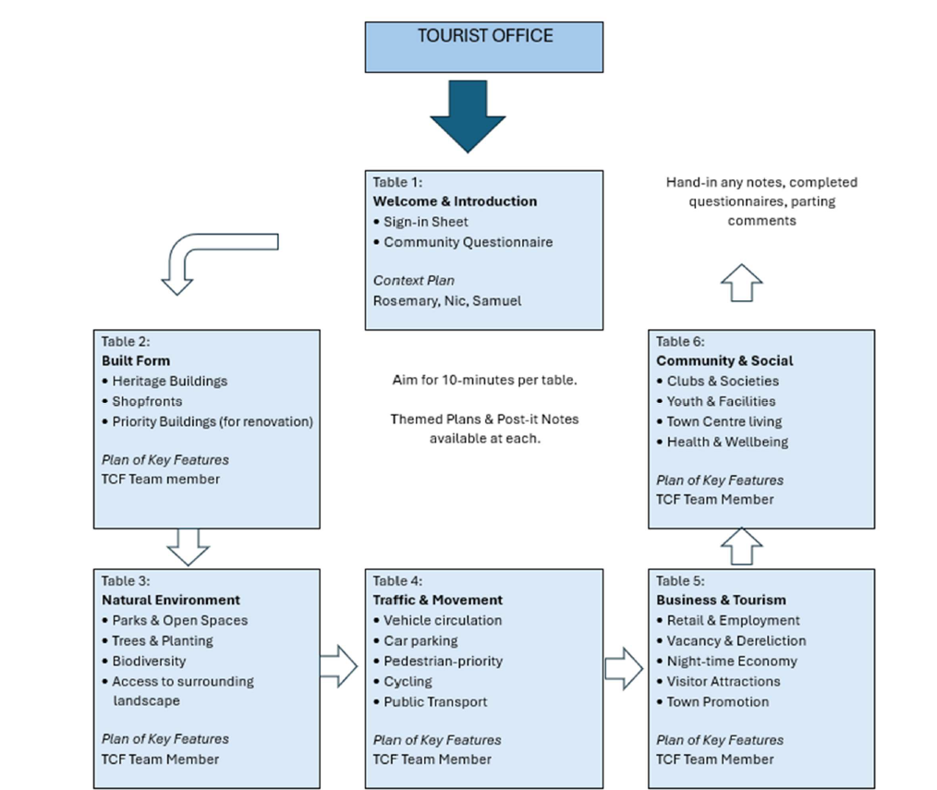
Meet the Town Team Event
Attended by approx. 50
Built Form:
  Community Spaces
  Town Centre Development
  Painting
  Age-Friendly Housing
Natural Environment:
  Green Spaces & Parks
  Sustainability
Traffic & Movement
  Pedestrianisation
  Cycling & Active Travel
  Public Transport & Parking
Business & Tourism
  Supporting Local Business
  Cultural & Touristic Initiatives
  Night-Time Economy
Community & Social
  Youth Services & Social Inclusion
  Community Groups
  Sports Infrastructure

